Slide 1
Bootstrap Glyphicons
廖向德

Slide 2
Glyphicon Syntax
The name part in the syntax above must be replaced with the proper name of the glyphicon.
Bootstrap Glyphicon Components

Slide 3
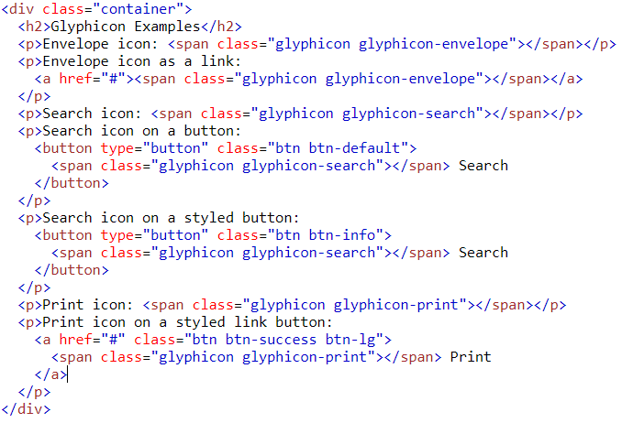
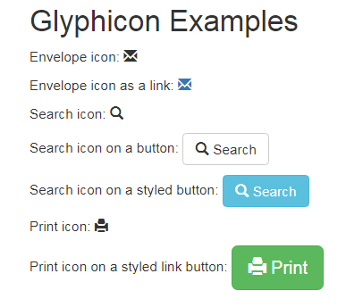
Example
Notes:
<!DOCTYPE html>
<html lang="en">
<head>
<title>Bootstrap Example</title>
<meta charset="utf-8">
<meta name="viewport" content="width=device-width, initial-scale=1">
<link rel="stylesheet" href="https://maxcdn.bootstrapcdn.com/bootstrap/3.3.7/css/bootstrap.min.css">
<script src="https://ajax.googleapis.com/ajax/libs/jquery/3.2.1/jquery.min.js"></script>
<script src="https://maxcdn.bootstrapcdn.com/bootstrap/3.3.7/js/bootstrap.min.js"></script>
</head>
<body>
<div class="container">
<h2>Glyphicon Examples</h2>
<p>Envelope icon: <span class="glyphicon glyphicon-envelope"></span></p>
<p>Envelope icon as a link:
<a href="#"><span class="glyphicon glyphicon-envelope"></span></a>
</p>
<p>Search icon: <span class="glyphicon glyphicon-search"></span></p>
<p>Search icon on a button:
<button type="button" class="btn btn-default">
<span class="glyphicon glyphicon-search"></span> Search
</button>
</p>
<p>Search icon on a styled button:
<button type="button" class="btn btn-info">
<span class="glyphicon glyphicon-search"></span> Search
</button>
</p>
<p>Print icon: <span class="glyphicon glyphicon-print"></span></p>
<p>Print icon on a styled link button:
<a href="#" class="btn btn-success btn-lg">
<span class="glyphicon glyphicon-print"></span> Print
</a>
</p>
</div>
</body>
</html>

